Slide 1

Introduction to Deep Learning with Watson Studio — Svetlana Levitan, PhD, and David Nichols, PhD Developer Advocate and Data Scientist IBM Cloud and Cognitive Software July 31, 2019

Slide 2





Intro to neural networks Deep Learning: CNN and RNN PMML and ONNX for model deployment AIFairness360 and ART, MAX Links and resources
Contents
Notes:
Deep learning is a subset of machine learning, more precisely, it is a subset of neural network models.
Machine learning can be used for predictive analytics, data mining, anomaly detection, and email filtering—among many other use cases.
Deep learning can be used for many tasks including image or audio classification, facial recognition, object recognition, image caption generation, and natural language processing.
There are many interesting things you can do today by integrating deep learning models into your application.

Slide 3
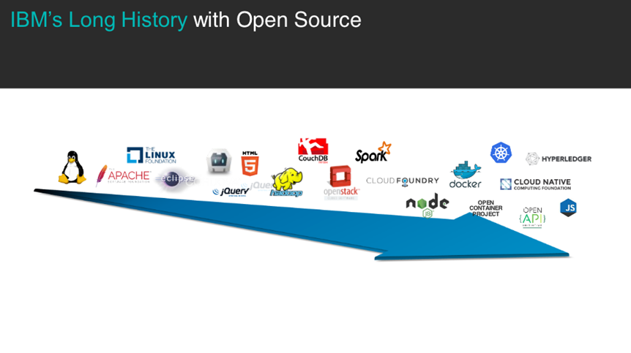


and open standards

Slide 4

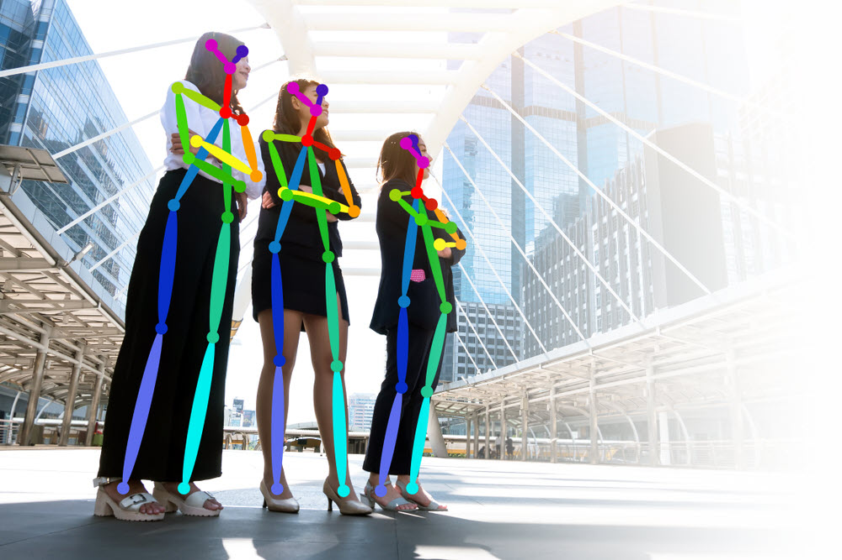
CODAIT
codait.org
codait (French)
= coder/coded
https://m.interglot.com/fr/en/codait
Center for Open Source Data and AI Technologies
CODAIT aims to make AI solutions dramatically easier to create, deploy, and manage in the enterprise
Relaunch of the Spark Technology Center (STC) to reflect expanded mission
Notes:
Lower the barrier of entrance ,
I am working for CODAIT team (center for open source data and AI technology), a group of data scientists and open source developers based on San Francisco, CA, some scattered around the world. CODAIT evolved from Spark Technology Center. We aim to make AI models dramatically easier to create, deploy, and manage in the enterprise.

Slide 5
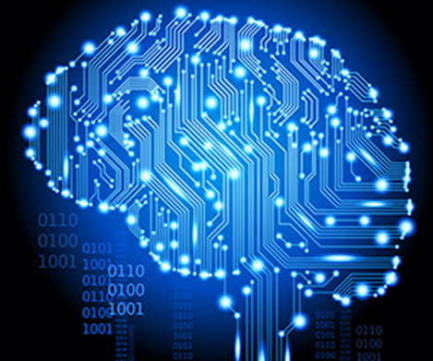
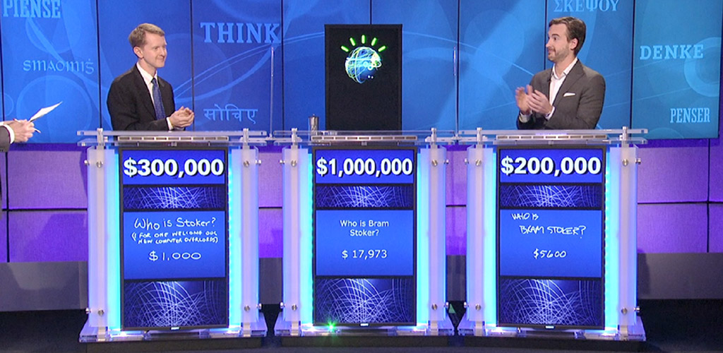
Who uses machine learning today?

Slide 6
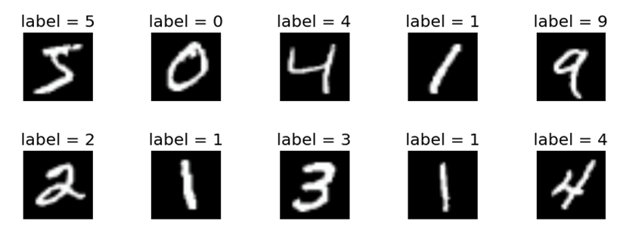
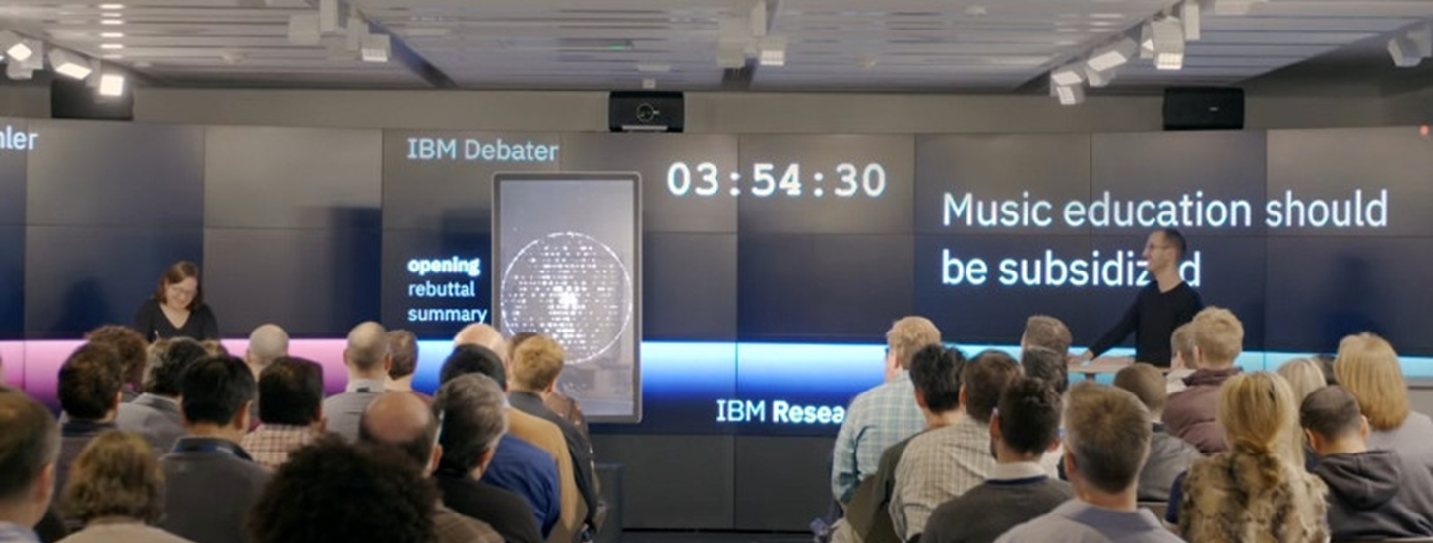
Some Applications of Machine Learning
Handwritten digit recognition
Weather forecast
Spam filters for email
Online shopping recommendations
Self-driving car
2011 Watson won Jeopardy
2018 Project Debater

Slide 7
Neural Network Architectures: Quick Tour

Slide 8
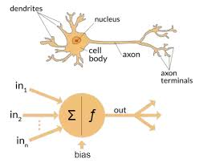
The Elementary Perceptron
1958 Frank Rosenblatt
A machine, first implemented in software on IBM 704, later hardware
1969 book by Minsky and Papert →AI winter
Then MLP = multilayer perceptron

Slide 9
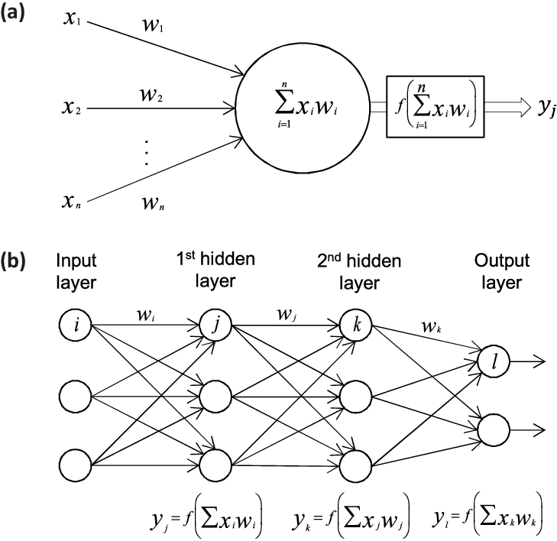
One neuron

Slide 10
Multi Layer Perceptron

Slide 11
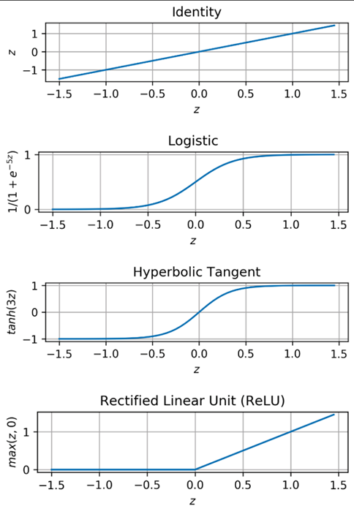

Activation Functions

Slide 12
A Simple Neural Network for Identifying Numbers
Input
Output
Fully
Connected
Fully
Connected
Fully
Connected
…
…
…
…
…
Output
Layer
(10 Neurons)
Hidden
Layer 1
(256 Neurons)
Hidden
Layer 2
(256 Neurons)
Input Image
(28x28 pixels)
Feature Vector
(784 values)
Input
Layer
(784 Inputs)

Slide 13
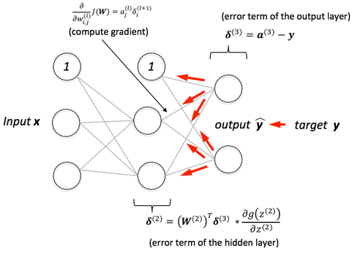
Training Neural Networks with Backpropagation
Initialize weights with small random values
Apply inputs, compute predictions, propagate error back and update weights
Gradient descent methods:
Adagrad, Adam, …
Online or mini-batch or batch

Slide 14
Labeled Training Data
Output Errors
❌
❌
Coat
T-shirt
Sneaker
Coat
Sneaker
T-shirt
❌
Sneaker
Pullover
Coat
Pullover
Backpropagation
Fashion-MNIST dataset by Zalando Research, on GitHub <https://github.com/zalandoresearch/fashion-mnist> (MIT License).
Notes:
In order to use a neural network, the neural network must first be trained.
To train a neural network:
Set the initial weights connecting each node
This can be done with random initialization
Or it can be done by utilizing an existing neural network, called transfer learning, which is generally more practical
Input labeled training data into the neural network
Input is processed through the neural network in a process called forward propagation
Update the weights to correct for errors through a process called backpropagation
Iterate and reduce the loss function until convergence, meaning the model is producing the ”correct” results
Let’s pause here for a moment to see if there are any questions at this point.

Slide 15
Neural Network Inferencing
Input
Output
Sneaker 98%
Fashion-MNIST dataset by Zalando Research, on GitHub <https://github.com/zalandoresearch/fashion-mnist> (MIT License).
Notes:
Once trained, a neural network may be used to make predictions based on input data. This is typically referred to as inferencing or sometimes scoring a model.

Slide 16
Building neural network in SKLearn
from sklearn.preprocessing import StandardScaler
scaler = StandardScaler()
# Fit only to the training data
scaler.fit(X_train)
# Now apply the transformations to the data:
X_train = scaler.transform(X_train)
X_test = scaler.transform(X_test)
from sklearn.neural_network import MLPClassifier
mlp = MLPClassifier(hidden_layer_sizes=(256,256),max_iter=500)
mlp.fit(X_train,y_train)
predictions = mlp.predict(X_test)
from sklearn.metrics import classification_report,confusion_matrix
print(confusion_matrix(y_test,predictions))

Slide 17
Convolutional neural networks

Slide 18
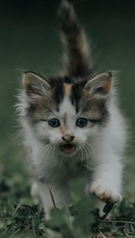

Convolutional Neural Networks (CNNs)
Widely used in processing of visual images or pictures
Photo by Ramdan Authentic

Slide 19
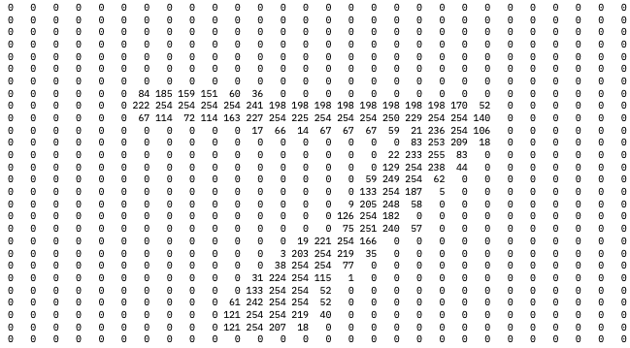
Image representation
Here’s the 28 x 28 set of numbers for the digit 7 image:
Notes:
An image is represented to a program by a set of numbers
Each number represents a pixel location and a “channel”
For greyscale images, only one channel per location
For color images, typically three channels per location (RGB)

Slide 20
Convolutional Neural Networks (CNNs)
CNNs typically involve use of several types of layers:
Convolutional
Pooling
Dropout
Flattening
Dense (Fully Connected)

Slide 21
Convolutional filters or kernels
Images on the following three slides are from Stanford University’s CS231n Convolutional Networks for Visual Recognition course notes, and are subject to:
The MIT License (MIT)
Copyright © 2015 Andrej Karpathy
Permission is hereby granted, free of charge, to any person obtaining a copy of this software and associated documentation files (the “Software”), to deal in the Software without restriction, including without limitation the rights to use, copy, modify, merge, publish, distribute, sublicense, and/or sell copies of the Software, and to permit persons to whom the Software is furnished to do so, subject to the following conditions:
The above copyright notice and this permission notice shall be included in all copies or substantial portions of the Software.

Slide 22
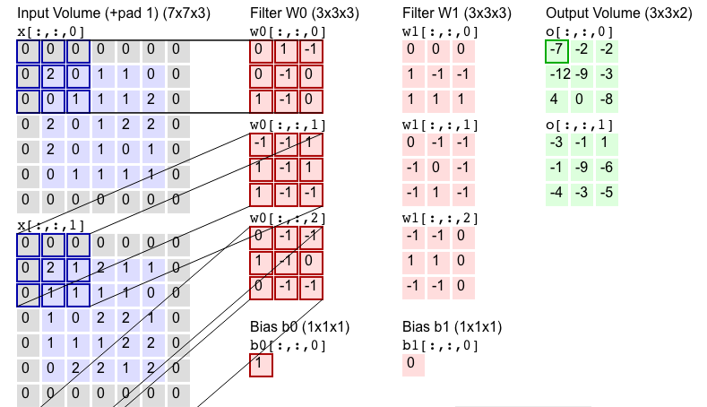
Convolutional layers

Slide 23
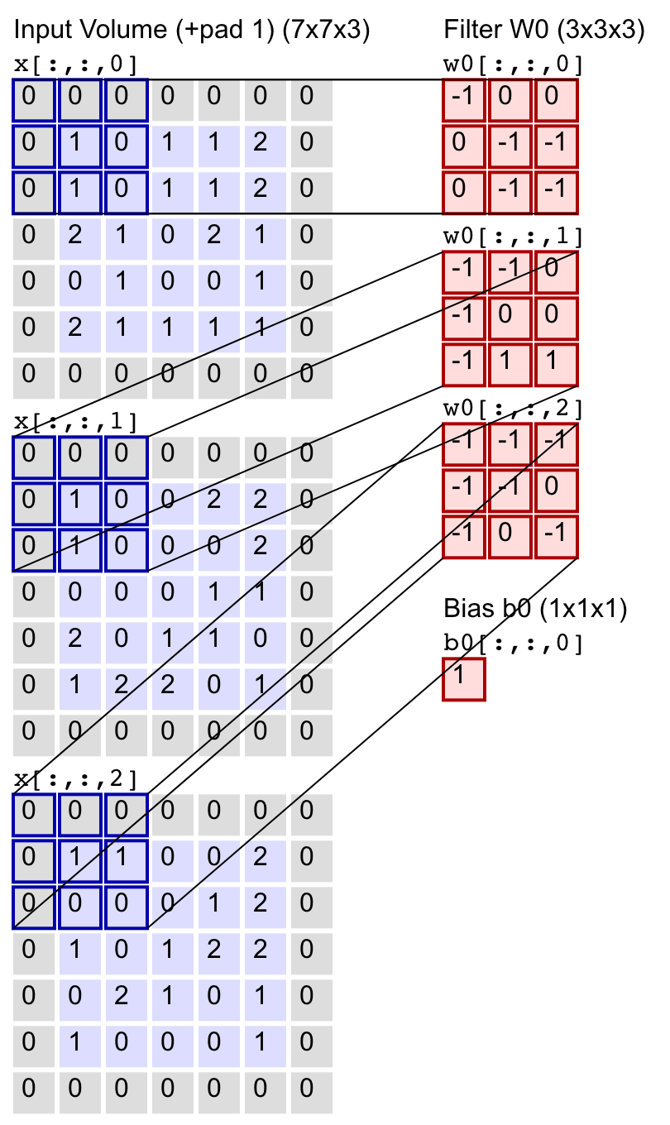
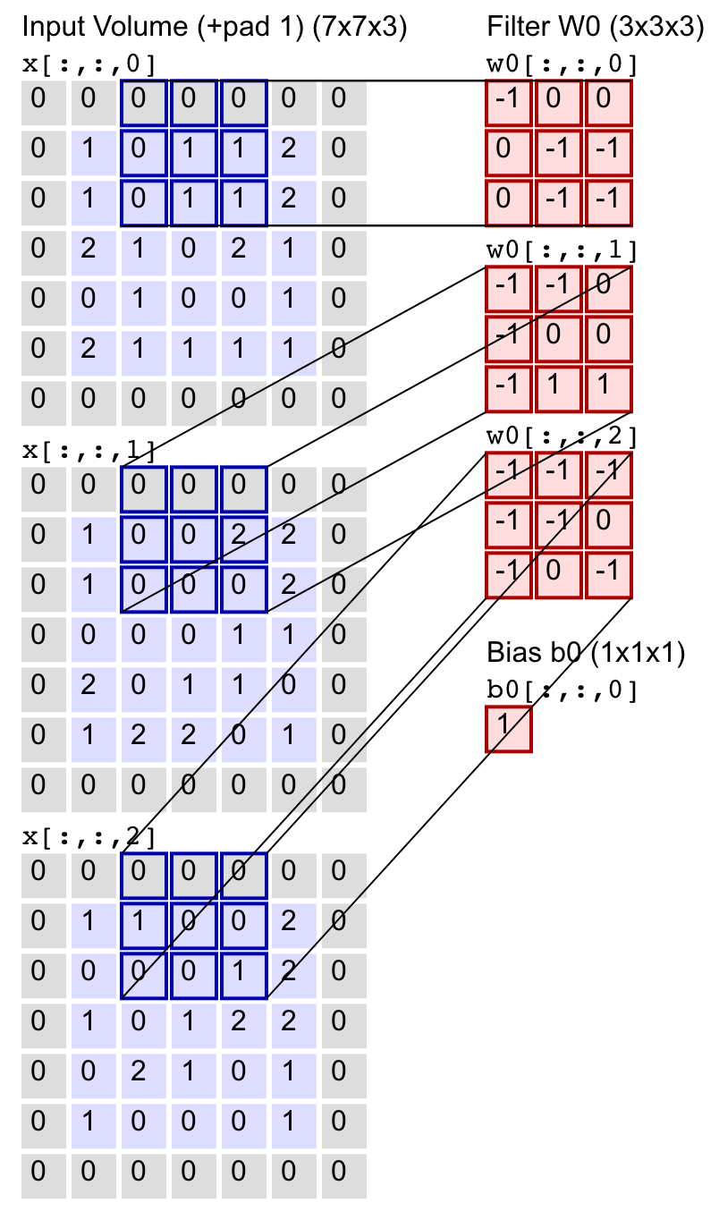
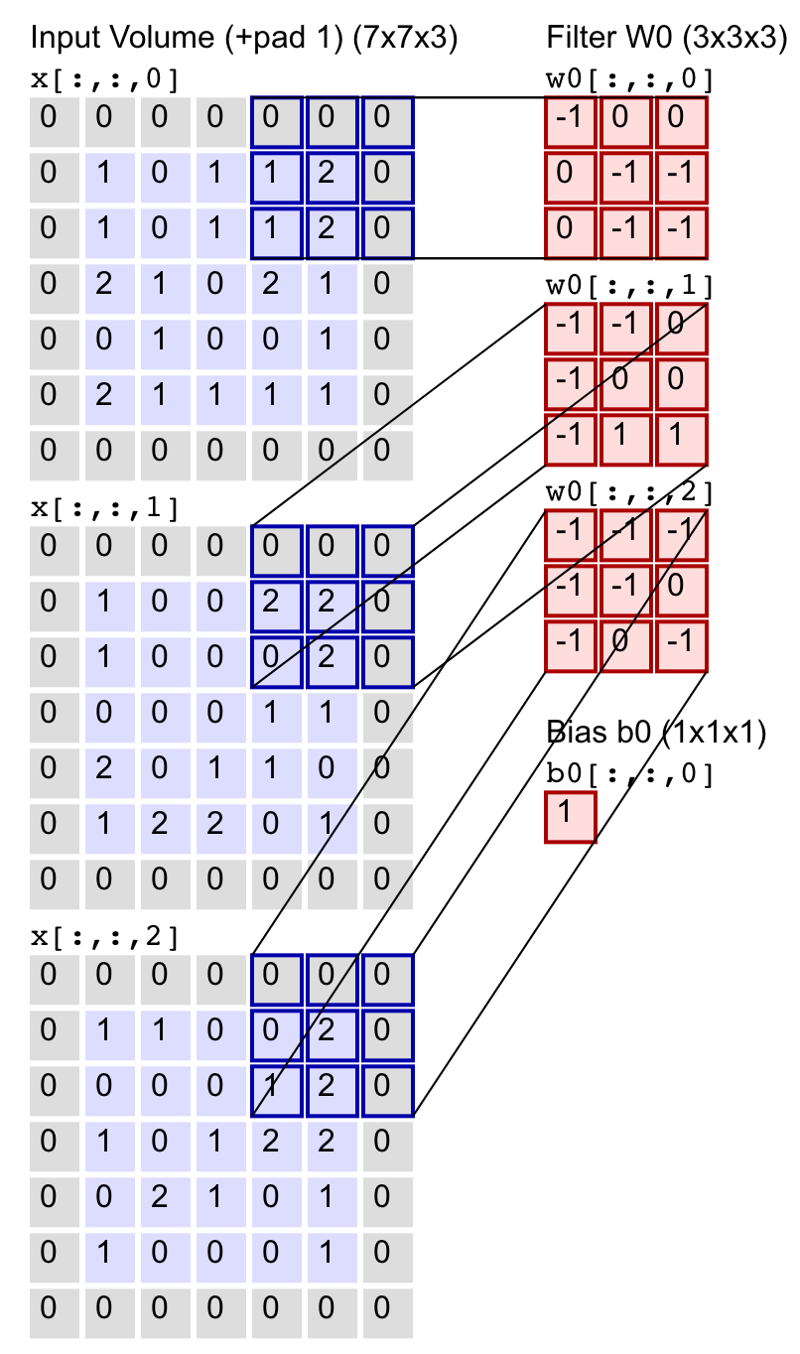
Convolutional filters or kernels

Slide 24
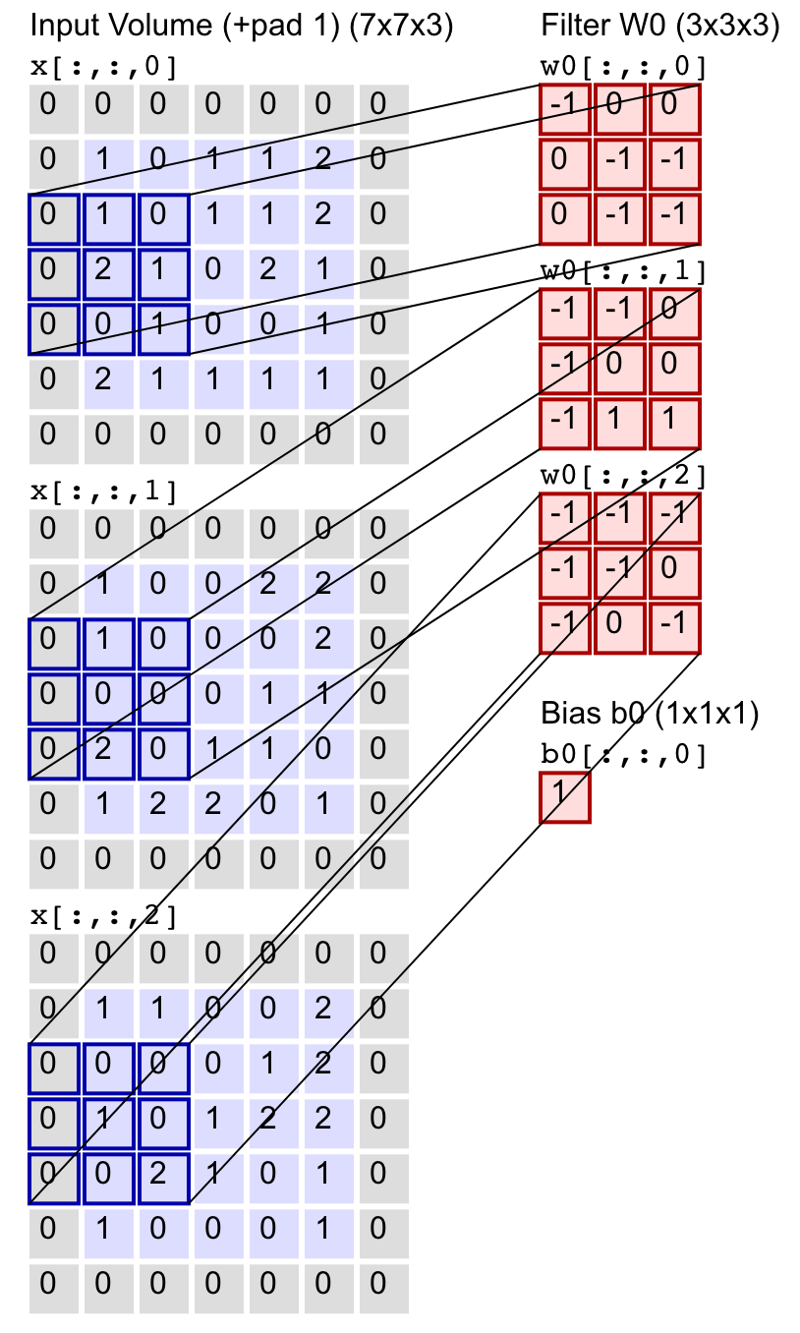
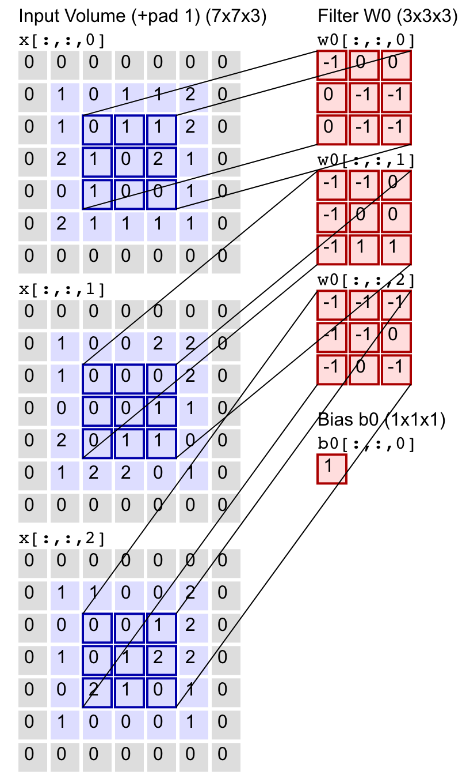
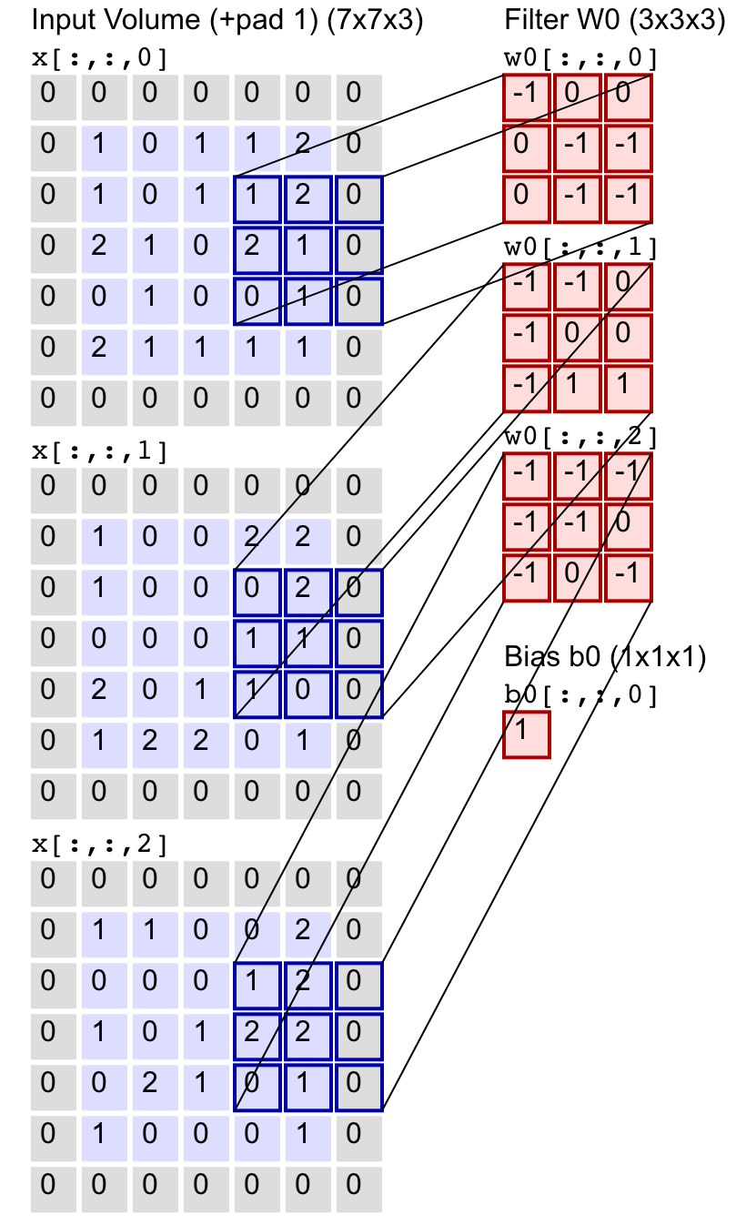
Convolutional filters or kernels

Slide 25

Pooling layers
Reduce activation map sizes and serve a regularization function
Most common is a 2 x 2 filter with strides (2,2) and taking the maximum of the four
values as the new single value (“max pooling”)
This reduces the size of the activation map by
75% and helps reduce overfitting
Diagram from quora.com

Slide 26
Dropout Layers
Also serve regularization function
N. Srivastava, G. Hinton, A. Krizhevskiy, I. Sutskever, R. Salahutdinov Dropout: A simple way to prevent neural networks from overfitting. J. of Machine Learning Research 15 (2014) 1929-1958

Slide 27
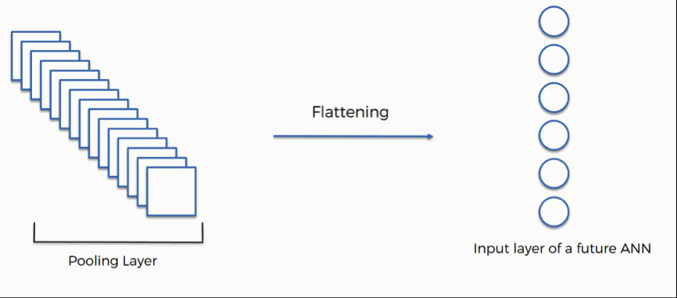
Flattening layer
https://towardsdatascience.com/the-most-intuitive-and-easiest-guide-for-convolutional-neural-network-3607be47480

Slide 28

Convolutional Neural Networks
https://towardsdatascience.com/a-comprehensive-guide-to-convolutional-neural-networks-the-eli5-way-3bd2b1164a53

Slide 29

Example Time! Python notebook and flows in IBM Watson Studio

Slide 30
Recurrent Neural Networks

Slide 31
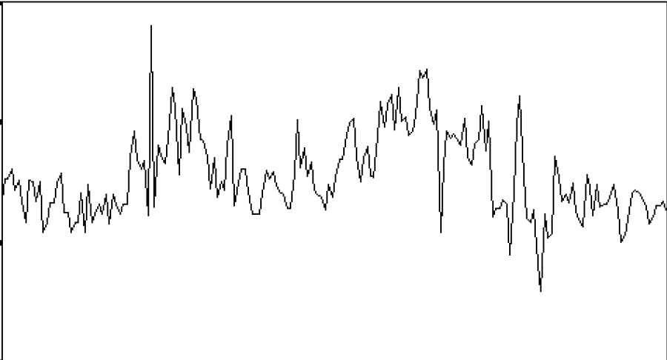
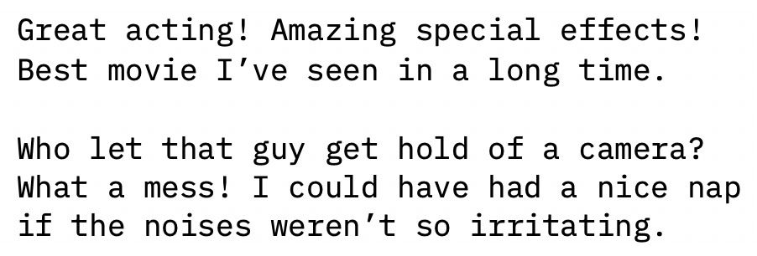
Recurrent Neural Networks (RNNs)
Some types of data inherently contain sequential aspects, such as:
Time series data Text data

Slide 32
Recurrent Neural Networks (RNNs)
RNN structures typically include the following types of layers:
Embedding (if analyzing text data)
Recurrent
Fully connected or dense

Slide 33
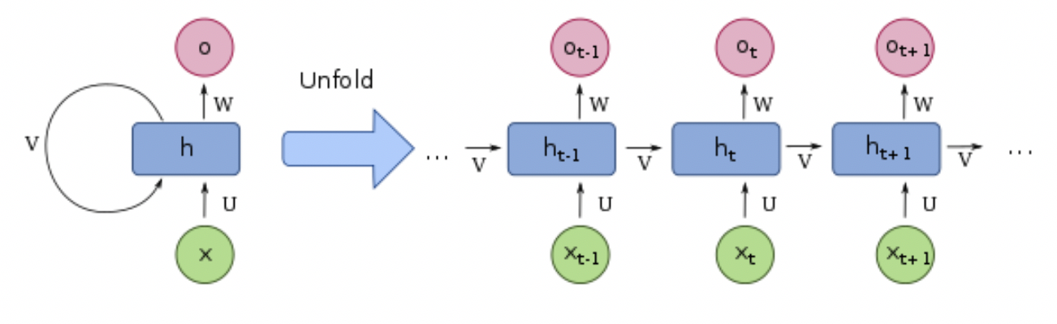
Recurrent Neural Networks (RNNs)
Simple recurrent network layer structure
By François Deloche - Own work, CC BY-SA 4.0, https://commons.wikimedia.org/w/index.php?curid=60109157

Slide 34
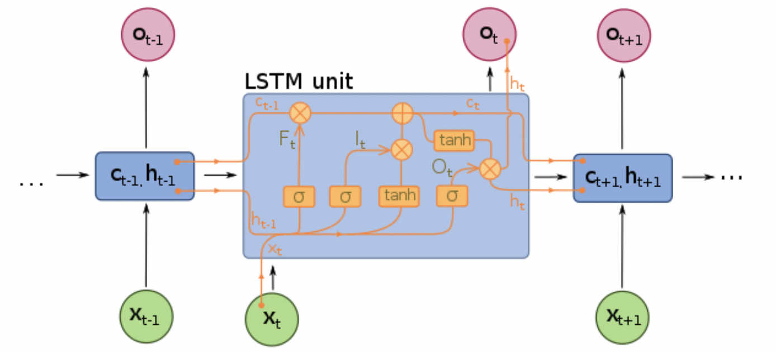
Long Short-Term Memory (LSTM) RNNs
By François Deloche - Own work, CC BY-SA 4.0, https://commons.wikimedia.org/w/index.php?curid=60149410

Slide 35
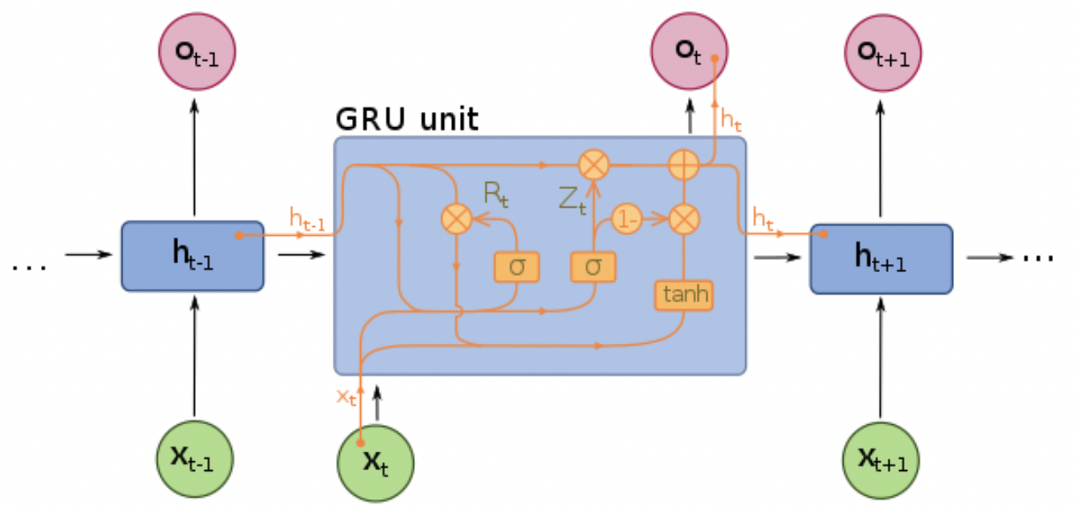
Gated Recurrent Units (GRU) RNNs
By François Deloche - Own work, CC BY-SA 4.0, https://commons.wikimedia.org/w/index.php?curid=60466441

Slide 36
Example Time! RStudio in IBM Watson Studio

Slide 37
Model deployment

Slide 38
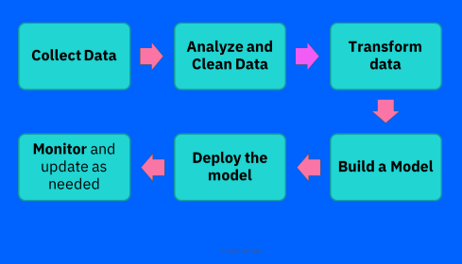
Model deployment
Challenges:
Different Teams
Different environments
Need to keep data prep steps
Solutions: open standards
PMML: Predictive Model Markup Language – XML based, >20 years
PFA: Portable Format for Analytics, JSON based, ~5 years
ONNX: Open Neural Network eXchange, Protobuf, < 2 years
Or Docker containers

Slide 39

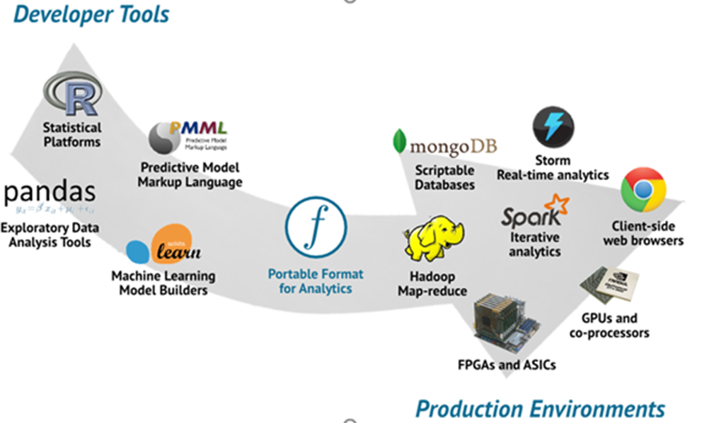
What are PMML and PFA?
XML and JSON for model exchange and deployment
PMML 0.7 in 1997, 1.1 in 2000, 4.4 in 2019
Used by >30 companies
and OS packages
dmg.org/pmml
PFA – small math
programming language
dmg.org/pfa
Notes:
IBM and SPSS among co-founding companies and leaders for DMG

Slide 40

Use of PMML and PFA in medical applications
Ludovic Claude,
CHUV
Lausanne,
Switzerland
Human Brain Project

Slide 41
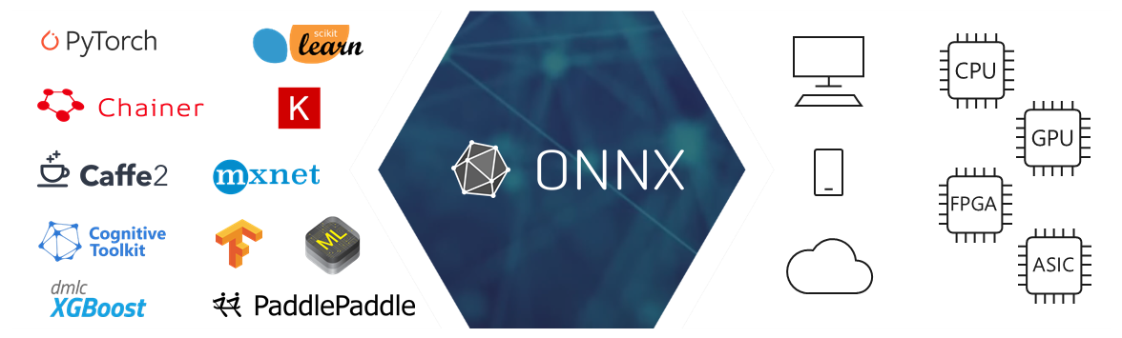
ONNX: Open Neural Network eXchange
Since 2017
Protobuf
Covers DL and traditional ML
Active work by many companies

Slide 42
Using ONNX in medical image processing: potential applications
MAX
ibm.biz/
model-exchange

Slide 43
Adversarial Robustness

Slide 44
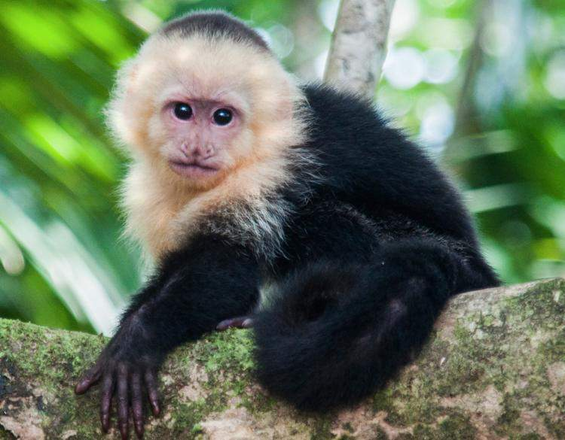
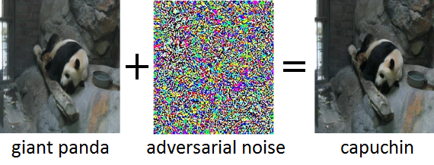
Deep learning and adversarial attacks
Deep Learning models are now used in many areas
Can we trust them?

Slide 45
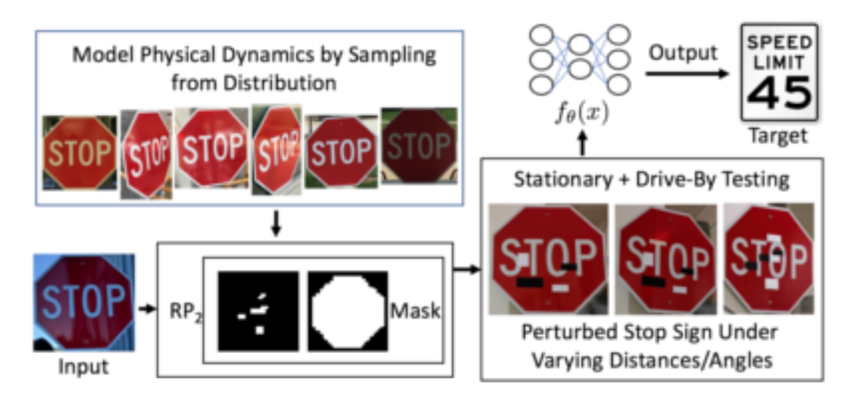
https://arxiv.org/pdf/1707.08945.pdf
Scarier example

Slide 46
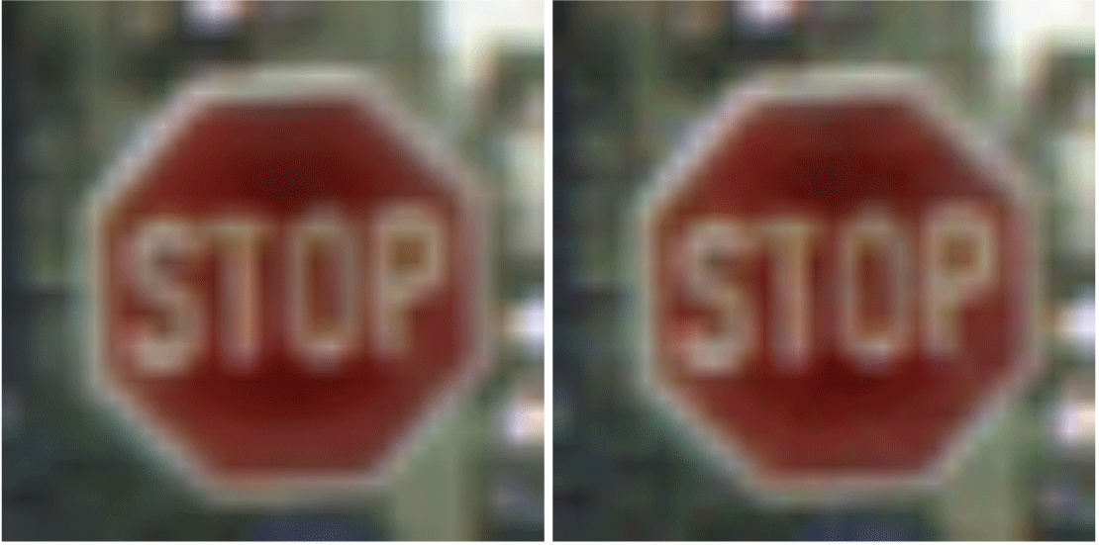

Adversarial Threats to AI
Data
poison
Evasion attacks
Performed at test time
Perturb inputs with crafted noise
Model fails to predict correctly
Undetectable by humans
Poisoning attacks
Performed at training time
Insert poisoned sample in training data
Use backdoor later
train
Neural Network
Attacker
output
input
perturb
benefit
$$$
result

Slide 47
How to defend? Taxonomy of defenses
Model Hardening
Robustness Metrics
Detection
Adversarial
Training
Data
Preprocessing
Model
Design
Attack
Independent
Attack
Specific
Statistical
Tests
Detector
Networks
Bayesian
Uncertainty
Static
BReLUs
CLEVER
MMD
Magnet
Dynamic
Saddlepoint
Optimization
Adversarial
Success Rates
Kernel Density
Estimates
Gaussian Data
Augmentation
Dimensionality
Reduction
Loss Sensitivity
Local Intrinsic
Dimensionality
Label Smoothing
Bayesian SVMs
Feature Squeezing
Detectors on Internal
Representations
Shattered Gradients
Detectors on Inputs
Dropout Uncertainty
Stochastic Gradients
Global Lipschitz Bound
Minimal Perturbation

Slide 48
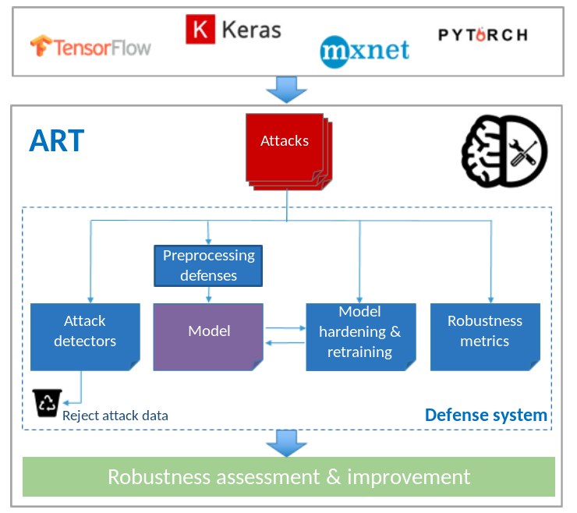

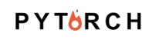


The Adversarial Robustness Toolbox (ART)
Library for adversarial machine learning
Baseline implementation of attacks and defenses for classifiers
Dedicated to images
MIT license
Supported frameworks:
48

Slide 49
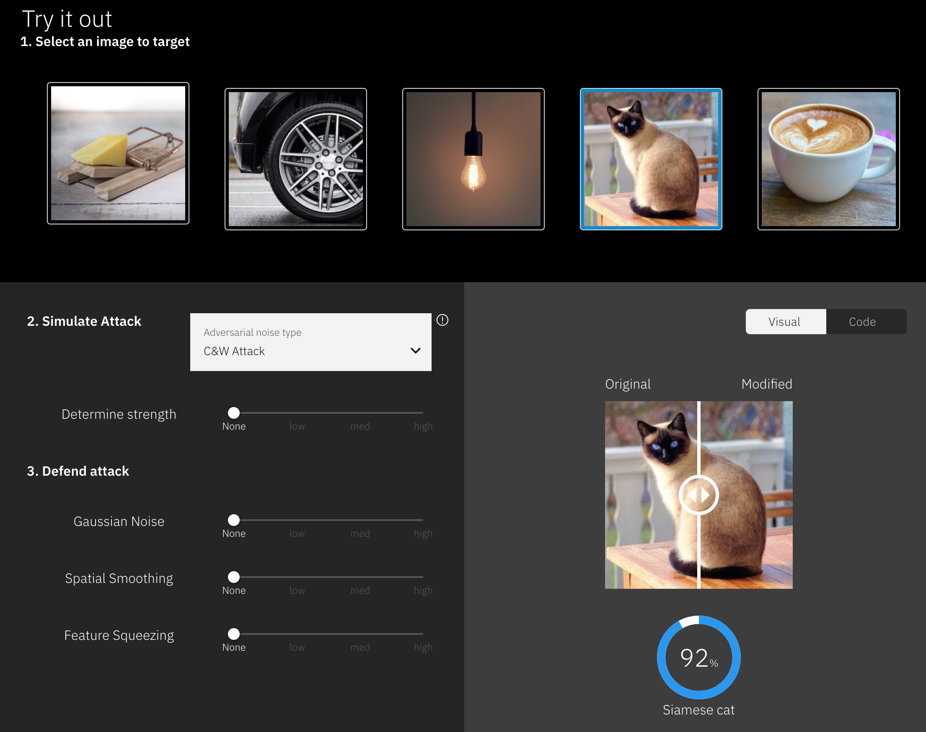

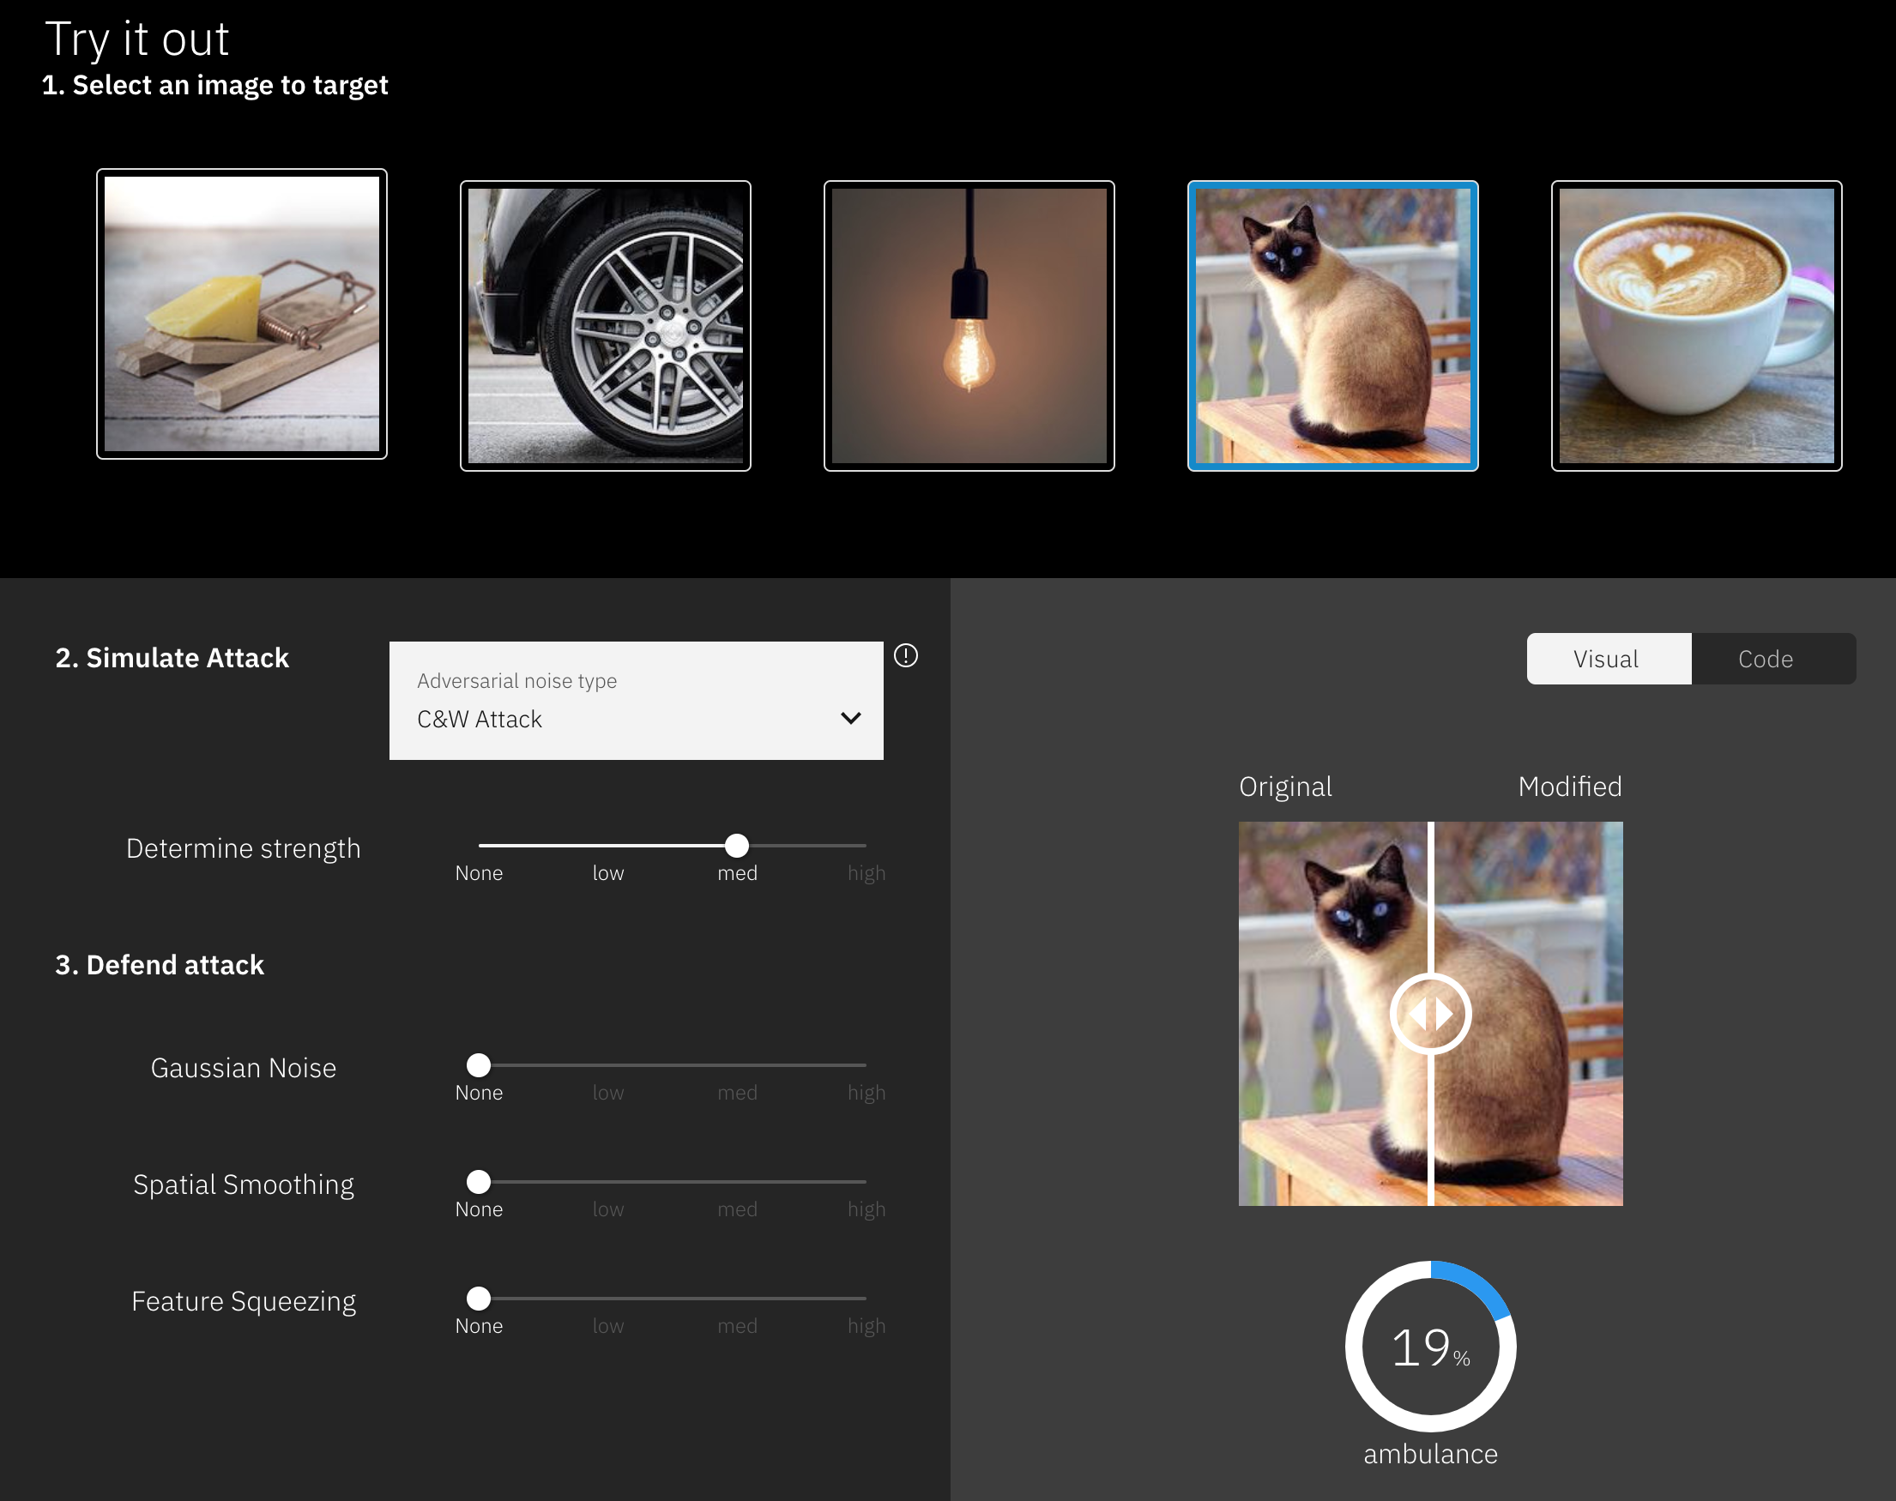
ART Demo: https://art-demo.mybluemix.net/

Slide 50
AI Fairness 360

Slide 51
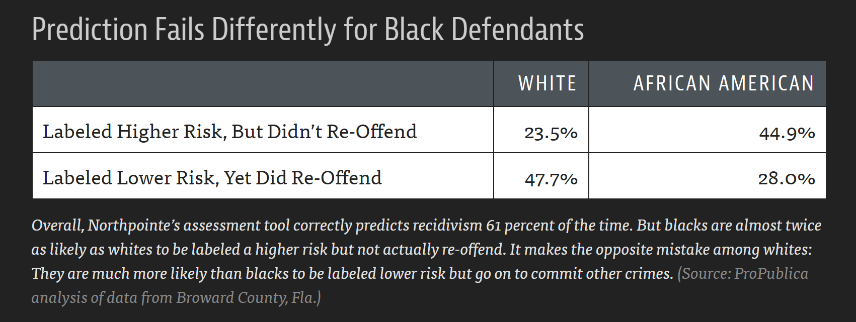
Are computer-generated results free of bias?
https://www.propublica.org/article/machine-bias-risk-assessments-in-criminal-sentencing

Slide 52
AIFairness 360
Open source Python library
70+ Fairness metrics and explanations
10 Bias mitigation algorithms

Slide 53
AIFairness 360: Some Metrics (out of 70+)
Statistical parity difference
Equal opportunity difference
Average odds difference
Disparate impact
Theil index
Euclidean distance
Mahalanobis distance
Manhattan distance

Slide 54
De-biasing algorithms
Optimized Preprocessing
Reweighing
Adversarial Debiasing
Reject Option Classification
Disparate Impact Remover
Learning Fair Repressentations
Prejudice Remover
Calibrated Equalized Odds Post-processing
Equalized Odds Post-processing
Meta Fair Classifier

Slide 55
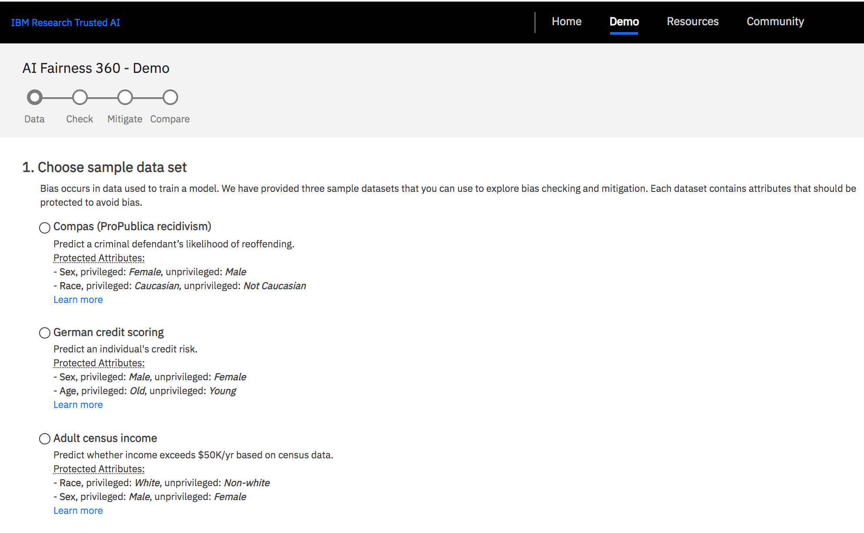
Demo Application: AI Fairness 360 Web Application
http://aif360.mybluemix.net/

Slide 56
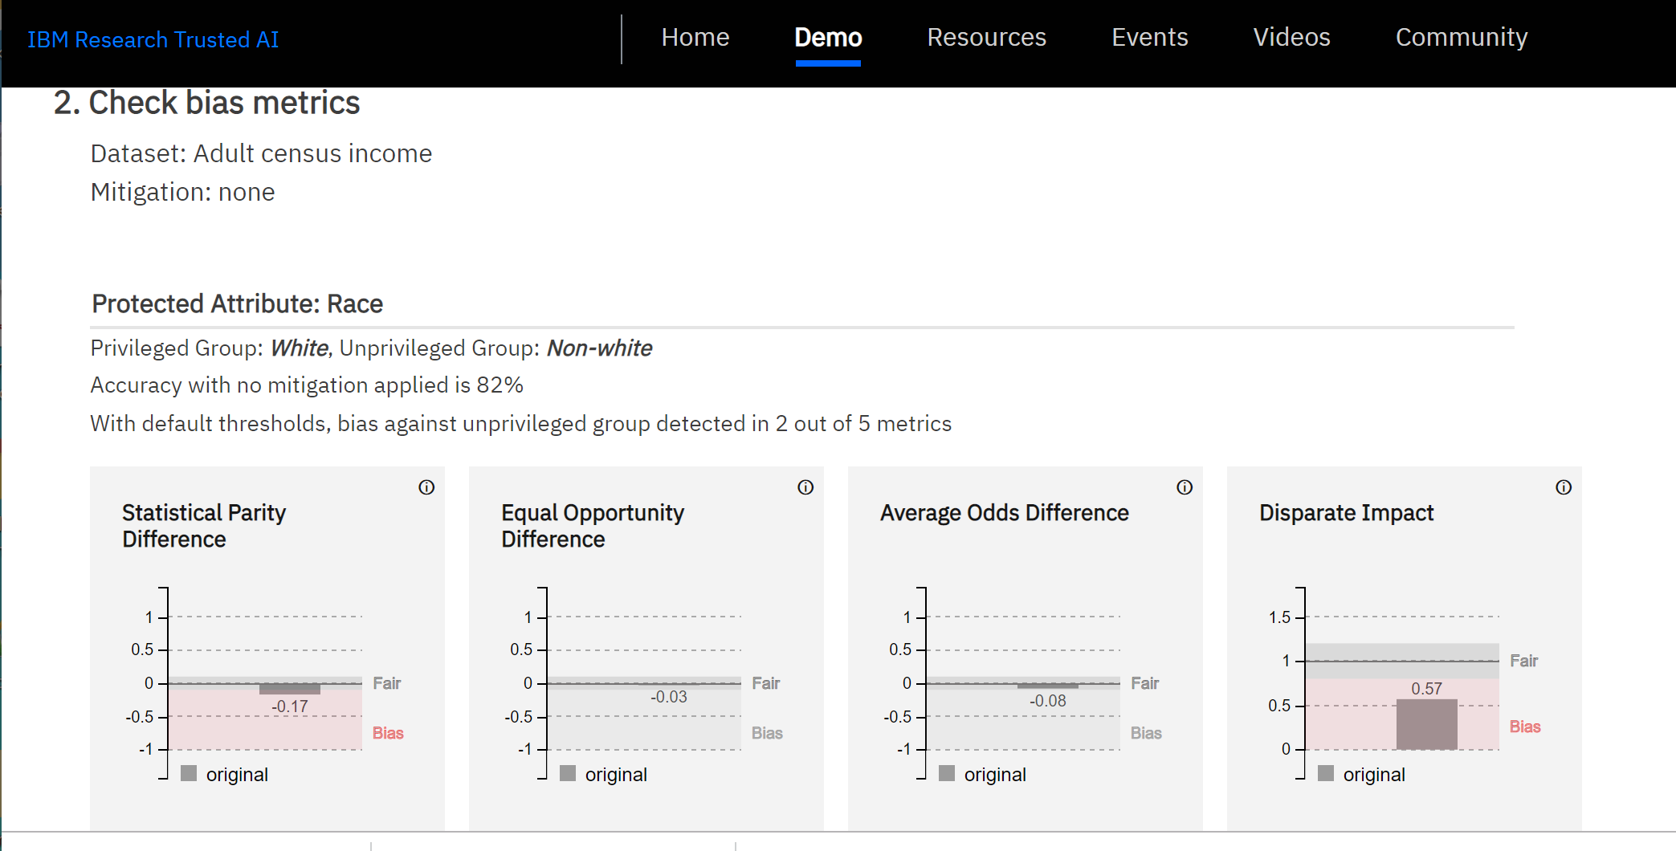

Slide 57
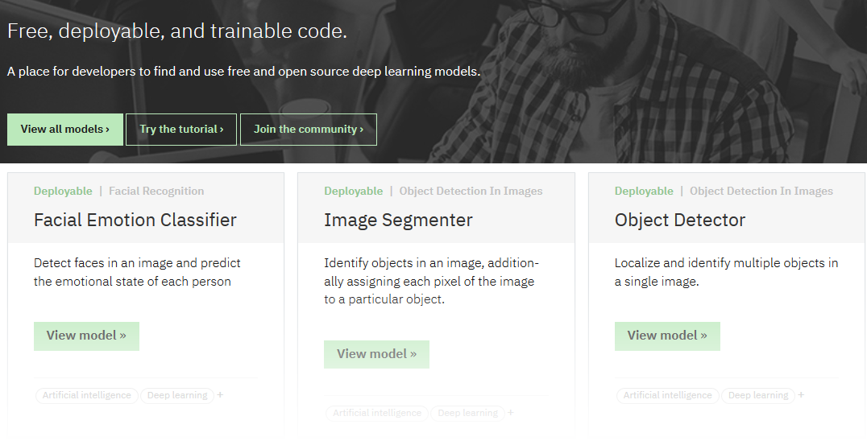
MAX: Reduces “time to value” for developers
Find model asset
Deploy pre-trained model asset
Use model asset
Audio classification
Image classification
Text classification
Object detection
Facial recognition
Image-to-image translation
Image-to-text translation
Named entity recognition
Text feature extraction
…
ibm.biz/model-exchange
Notes:
- Little/no AI expertise required to get started - Low barrier to entry (no registration, no paid services required) - … but a potential on-ramp for paid services (e.g. Watson ML) - Open-source, fully vetted, ready to consume assets (short Time to Value) - Container-based microservice (programming language agnostic) - IOT support through Node-RED module - In-browser support through JavaScript/Node.js packages - No vendor lock-in (supports major ML frameworks) - State-of-the-art models for well-understood problem domains

Slide 58
↳ Deep Learning Code Patterns
https://developer.ibm.com/patterns/category/model-asset-exchange/
Notes:
We have a number of other deep learning Code Patterns available on IBM Developer. These include examples of image caption generation, audio classification, object detection, and age estimation.

Slide 59
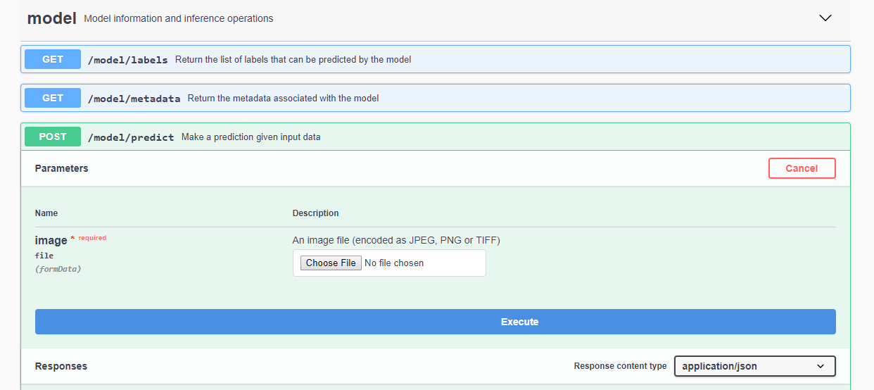
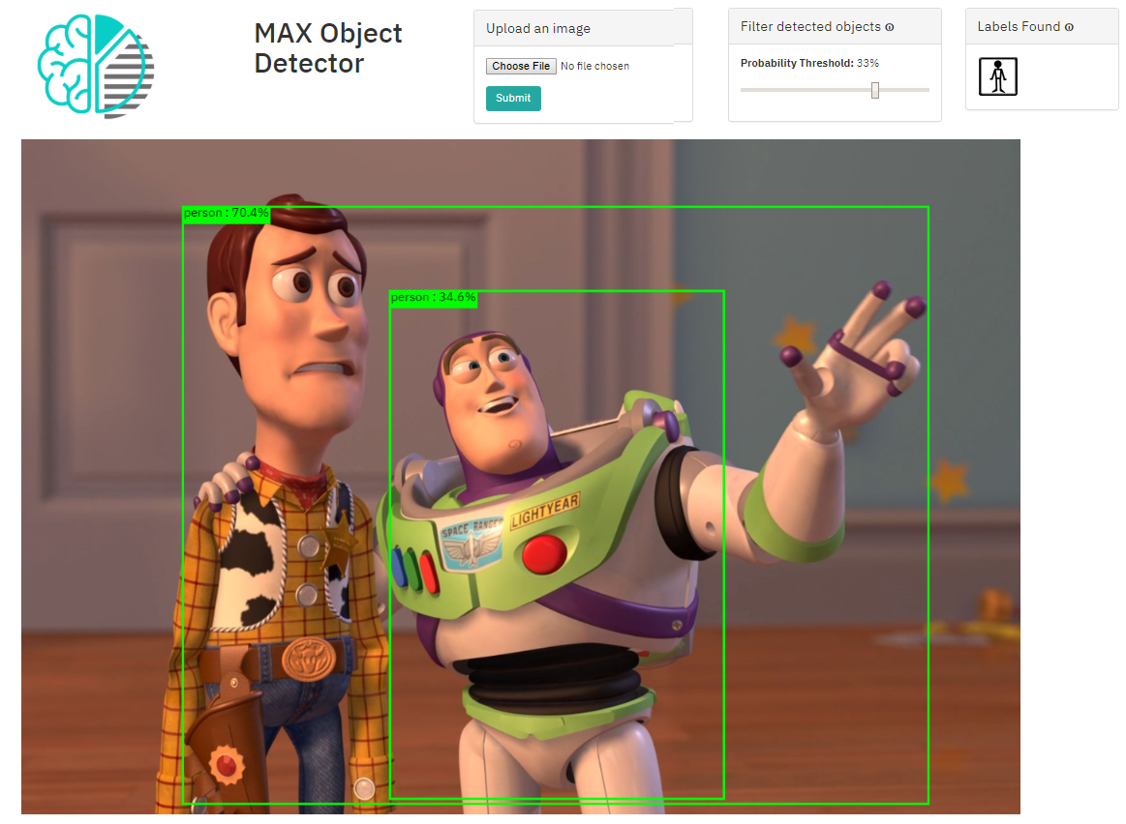
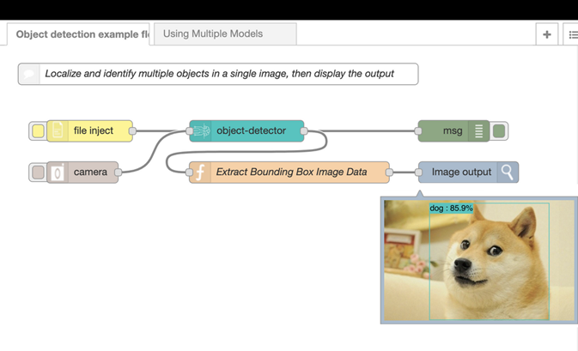
MAX Consumption scenarios - Model-serving microservice (Docker-based) - Internet of Things: Node-RED - JavaScript/Node.js packages

Slide 60
IBM Data Asset eXchange (DAX)
Curated free and open datasets under open data licenses
Standardized dataset formats and metadata
Ready for use in enterprise AI applications
Complement to the Model Asset eXchange (MAX)
Data Asset eXchange
ibm.biz/data-asset-exchange
Model Asset eXchange
ibm.biz/model-exchange

Slide 61

Conclusions
Deep neural networks are used widely
IBM Watson Studio provides tools for model building, deployment, monitoring, as well as detection and remediation of bias and adversarial attacks
MAX models are ready to use in a variety of applications

Slide 62
Learn more on deep learning
Watson Studio: sign up for IBM Cloud: https://ibm.biz/Bdz4N5
Codait.org Onnx.ai @SvetaLevitan @dpnichols
AIFairness 360: https://github.com/IBM/AIF360
ART: https://github.com/IBM/adversarial-robustness-toolbox
MAX: ibm.biz/model-exchange

